Slide 1

Network Layer: IPv4 Static Routing
Lecture 10 | CSE421 – Computer Networks
Department of Computer Science and Engineering School of Data & Science

Slide 2
Objectives
Routing
Static Routing
Standard Static Routing
Directly attached/connected
Next Hop/Recursive
Fully Specified
Summary Static Routing
Default Static Routing
Floating Static Routing

Slide 3
Learning About Networks
A router can learn about remote networks in one of two ways:
Manually - Remote networks are manually entered into the route table using static routes.
Dynamically - Remote networks are automatically learned using a dynamic routing protocol.
Notes:
3
6.1.1.1

Slide 4
Static Route
A static route is created, maintained, and updated by a network administrator, manually.
A static route to every network must be configured on every router for full connectivity.
Notes:
If there is no dynamic routing protocols

Slide 5
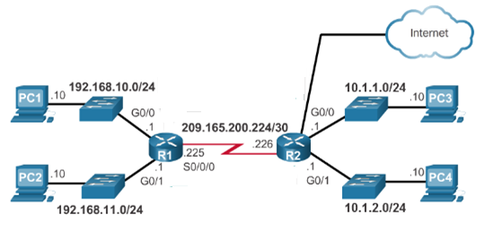
Learning About Networks
Table of R1
Network | Exit Int
192.168.10.0/24 | G0/0
192.168.11.0/24 | G0/1
209.165.200.224/30 | S0/0/0
Table of R2
Network | Exit Int
10.1.1.0/24 | G0/0
10.1.2.0/24 | G0/1
209.165.200.224/30 | S0/0/0
220.20.20.0/30 | G0/2
20.20.20.0/30
Directly connected
Directly connected
10.1.1.0/24
S0/0/0
10.1.2.0/24
S0/0/0
192.168.10.0/24
S0/0/0
192.168.11.0/24
S0/0/0
S0/0/1
S0/0/0

Slide 6
Static Route Advantages
Static routing provides some advantages over dynamic routing, including:
Static routes are not advertised over the network, resulting in better security.
Routers not share static routes with each other, thus reducing CPU/RAM overhead and saving bandwidth.
Notes:
6
Advantage of static routing
It is most secure way of routing, since no information is shared with other routers.
It puts no overhead on resources such as CPU or memory.
No routing algorithm or update mechanisms are required. Therefore, extra resources (CPU and memory) are not required.
It is easy to implement.

Slide 7
Static Route Disadvantages
Static routing has the following disadvantages:
Initial configuration and maintenance is time-consuming.
Configuration is error-prone, especially in large networks.
Administrator intervention is required to maintain changing route information.
Does not scale well with growing networks; maintenance becomes cumbersome.
Requires complete knowledge of the whole network for proper implementation.
Notes:
7
6.1.1.2

Slide 8
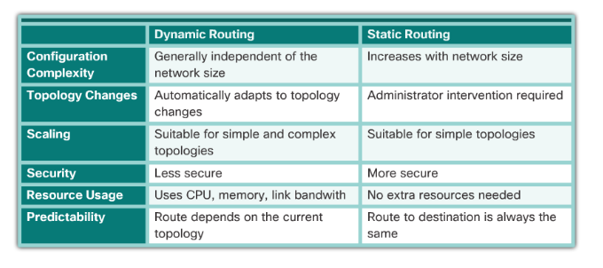
Comparison

Slide 9
Static Route Applications : Types
Static Routes are often used to:
Connect to a specific network
Provide a Gateway of Last Resort for a stub network – Default Gateway
Summarize routing table entries
Create a backup route in case a primary route link fails
Notes:
9
Reduce the number of routes advertised by summarizing several contiguous networks as one static route

Slide 10
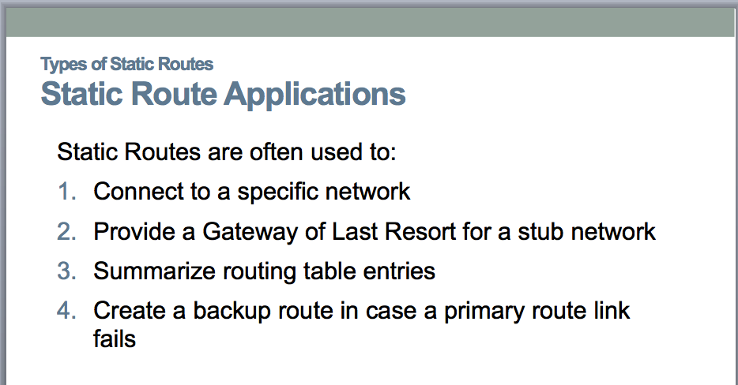
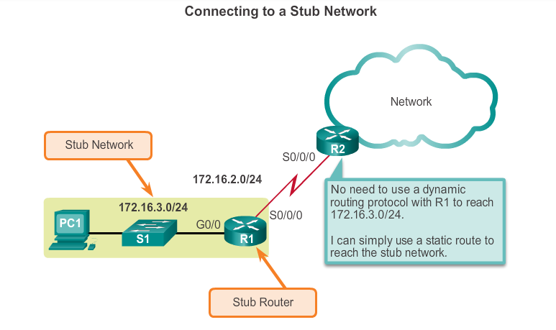
Standard Static Route
Static route can be used to connect to a specific network ( like for example a stub network)
Notes:
10
6.1.2.2

Slide 11
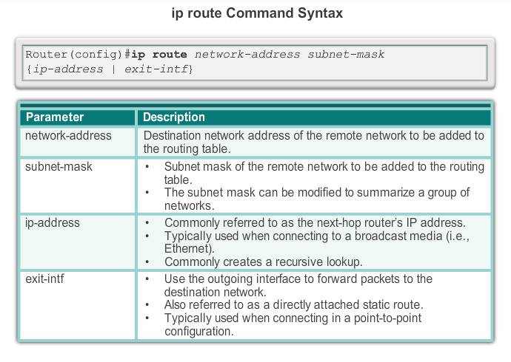
ip route Command
Next hop
Notes:
11
6.2.1.1

Slide 12
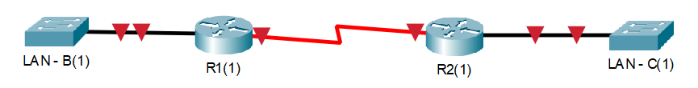
Next Hop Options
Directly attached/connected static route
Only the router exit interface/port name (i.e. s0/0) is specified.
Next-hop/Recursive lookup static route
Only the next-hop IP address (i.e. 2.2.2.2) is specified.
Fully specified static route
The next-hop IP address and exit interface (i.e. s0/0 2.2.2.2) are specified.
**Note: Port labels:
Each port has a name (s0/0 or f0/0 or g0/0 or etc.) and an IP address (1.2.3.4 or etc.)
.1
2.2.2.0/30
.2
S0/0
S0/1
**Configuring R1(1) towards LAN – C
***All settings are done from R1(1)’s perspective

Slide 13
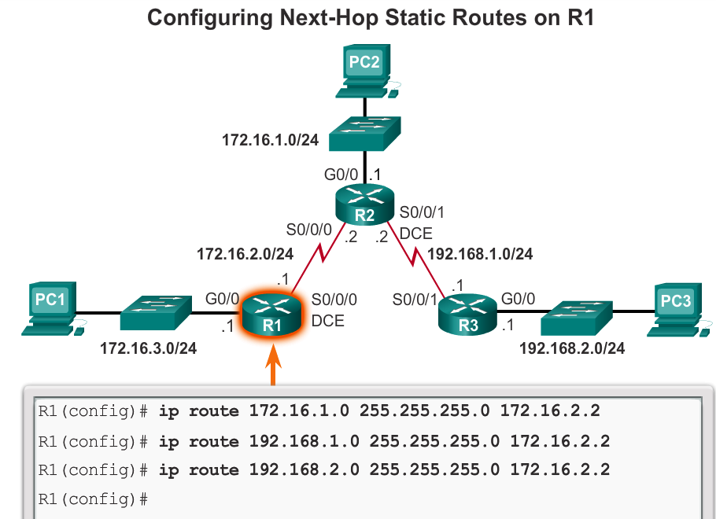
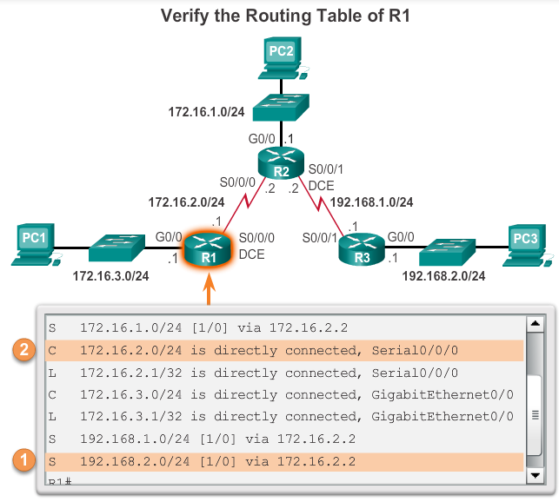
Standard Static Route using next hop IP address
Recursive Lookup
Notes:
When a packet is destined for the 192.168.2.0/24 network, R1:
1. Looks for a match in the routing table and finds that it has to forward the packets to the next-hop IPv4 address 172.16.2.2.
2. R1 must now determine how to reach 172.16.2.2; therefore, it searches a second time for a 172.16.2.2 match.

Slide 14
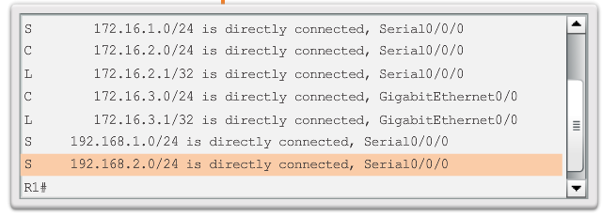
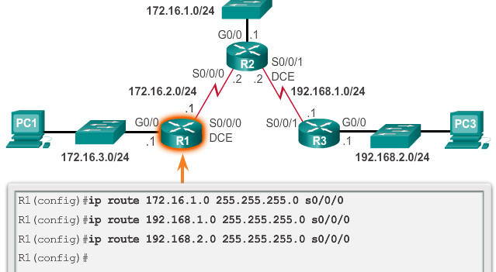
Standard Static Route using Exit Interface

Slide 15
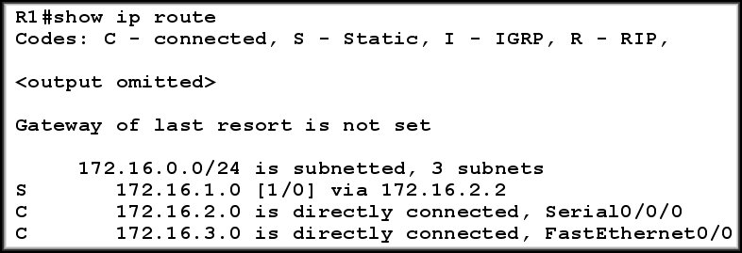
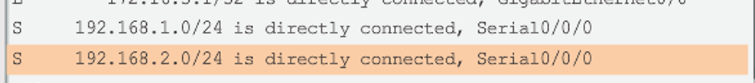
Static Route : The line and AD explained
Type of route:
S - Static
Destination Network
Cost of Path
Next Hop IP
Or, Exit Interface
Or, Fully Specified
Administrative
Distance
Static Routing table record if it was configured with Exit Interface
NOTE : AD of Static Routes is 1 and AD of Directly Connected Routes is 0

Slide 16
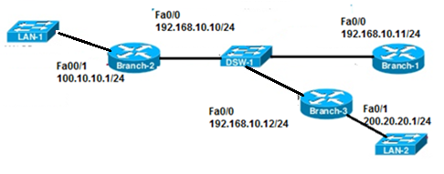
Configuring a Fully Specified Static Route
Both the output interface and the next-hop IP address are specified.
It’s used when the output interface is a multi-access interface and it is necessary to explicitly identify the next hop else, the Router will have difficulty determining the destination MAC address.
Network 1: 100.10.10.0/24
Network 2: 192.168.10.0/24
Network 3: 200.20.20.0/24
Branch-2(config)#ip route 200.20.20.0 255.255.255.0 fa0/0 192.168.10.12
Recommended

Slide 17
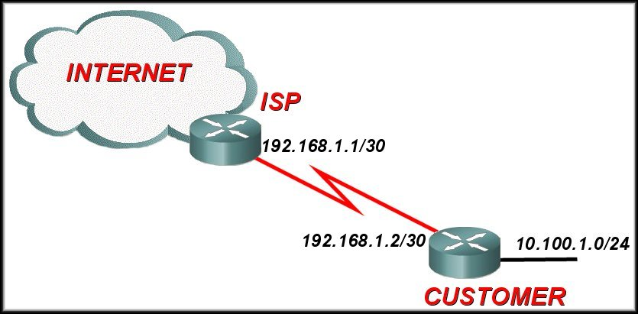
Default Static Routing
A default path to send all IP packets
when no other routes in the routing table match the packet destination IP address.
when a router has only one other router to which it is connected. This condition is known as a stub router.
Uses a special network address as destination: 0.0.0.0/0
Has a subnet mask of 0. Meaning, it will check zero bits and hence it will match all IPs!
Conventionally, always points towards the border/ISP Router.
Configuring a default static route creates a Gateway of Last Resort.

Slide 18
Configuring Default Static Route
**Note: A static route usually always points towards the specific network, while default static route points towards outside the network where a border router is connected to the internet
ip route 10.100.1.0 255.255.255.0 192.168.1.2
ip route 0.0.0.0 0.0.0.0 192.168.1.1

Slide 19
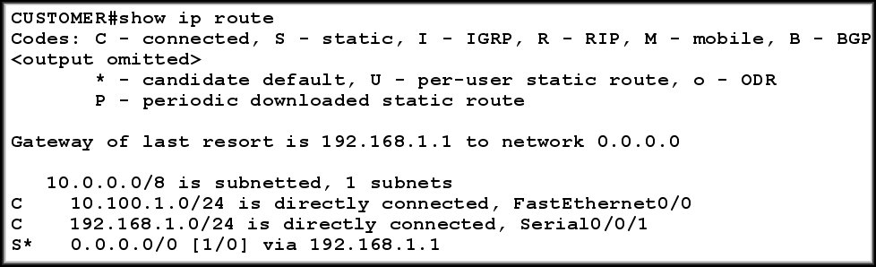
Verifying Default Static Route

Slide 20
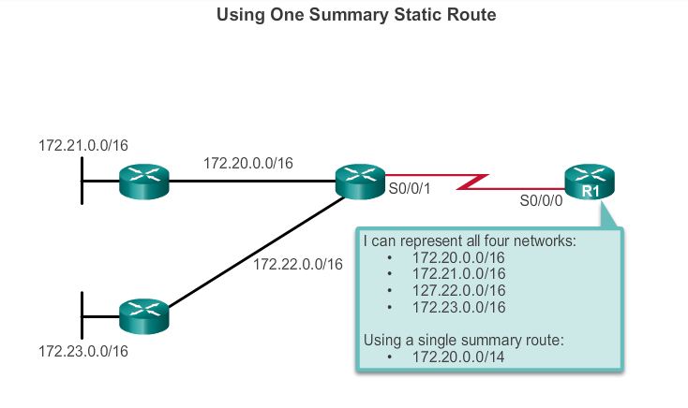
Summary Static Routing
A summary route is a single route that can be used to represent multiple routes.
Creates smaller routing tables
More efficient routing table lookup process.
Reduce the number of routes advertise
Have the same exit interface or next-hop IP address.
Generally a set of contiguous networks.
Notes:
20
6.1.2.4

Slide 21
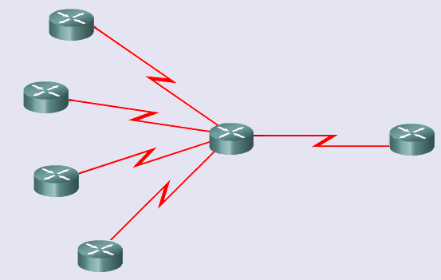
Route Summarization
How many entries does Router A and Router B have in it’s routing table?
201.1.32.0/22
201.1.40.0/22
Advertise all 4?
Router B
Router A
Keep all 4 entries in routing table?
201.1.48.0/24
201.1.56.0/24

Slide 22
Route Summarization
Octet 3 in binary
00100000 00101000 00110000 00111000
201.1.32.0/22
201.1.40.0/22
201.1.48.0/24
201.1.56.0/24
Summarized Network Address
201.1.32.0/19
Same
Difference starts here
Same
Difference starts in this octet (Octet 3)
201.1.00100000.0/19
19 bits the same so use /19 for summary

Slide 23
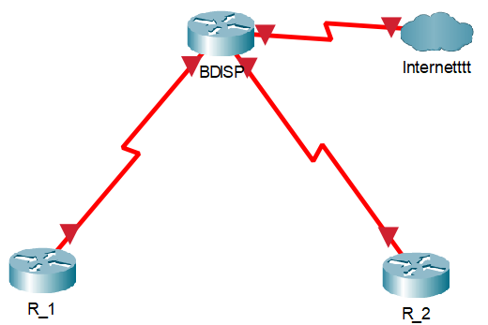
Problem of Summary Static Routing
192.16.0.0/22
192.16.0.0/22
192.16.0.0/24
192.16.2.0/24
192.16.1.0/24
192.16.3.0/24
Discontiguous Networks

Slide 24
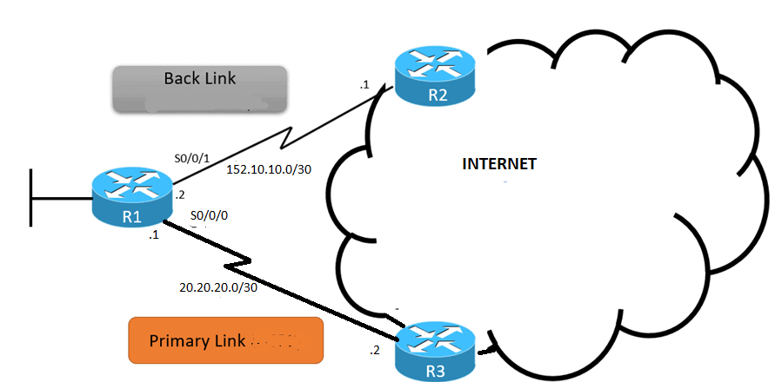
Floating Static Routing
Source : https://study-ccna.com/floating-static-route/

Slide 25
Floating Default Static Routing
R1 Routing Table (Partial)
S* 0.0.0.0/0 is directly connected, S0/0/0
S* 0.0.0.0/0 is directly connected, S0/0/1
Both has same cost same AD. Which one to use?
Present in Routing Table
R1(config)#ip route 0.0.0.0 0.0.0.0 S0/0/0
R1(config)#ip route 0.0.0.0 0.0.0.0 S0/0/1
5
AD > default Value
Present in Router Configuration File

Slide 26
Floating Static Routing
Create a backup route in case a primary route link fails
Uses Administrative Distance (AD)
The primary path has the default AD of 1 (but, may be configured to have a higher value)
The value of AD of back up path is greater than the AD of primary path/route.
Since the AD of primary path is lower, it means that primary path is more trustworthy and hence ignore the back up path unless the primary path is down.
The static route “floats” and is not used when the route with the better administrative distance is active.
If the preferred route is lost then the floating static route can take over

Slide 27
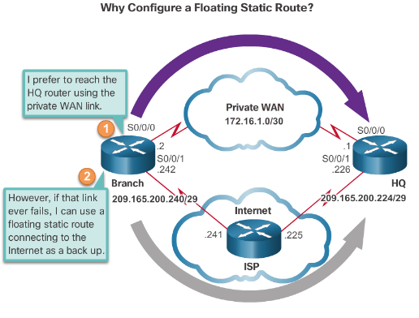
Configuring a Floating Static Route
Branch(config)#ip route 209.165.200.224 255.255.255.240 S0/0/0
Branch(config)#ip route 209.165.200.224 255.255.255.240 S0/0/1 5
*In other words, the AD has to be more than the AD of sthe primary route.
** A primary route may be set to have other AD values
**There can be more than one back up route, or, a back up of the back up route.
AD > 1

Slide 28
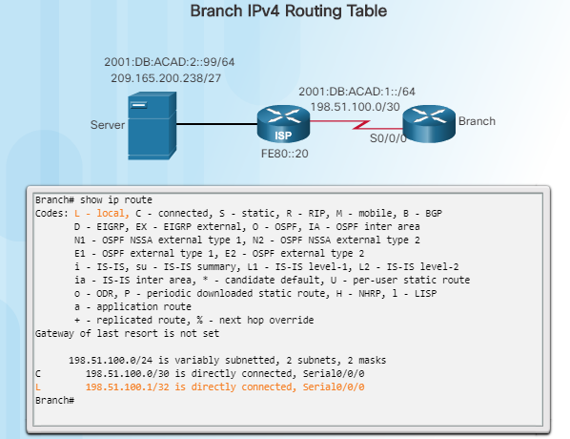
Automatically Installed Host Routes

Slide 29
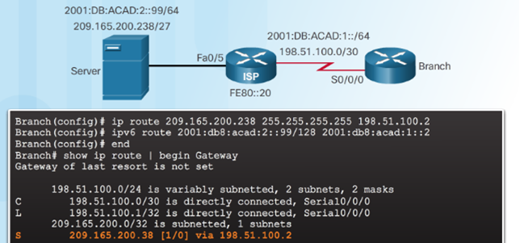
Configure IPv4 Static Host Routes

Slide 30
Commands to Verify Static Routes
Along with ping and traceroute, useful commands to verify static routes include:
show ip route
show ip route static
show ip route network

Slide 31
The End

